Slide 1
A Power Flow Control Scheme for a Photovoltaic to a Low Voltage Microgrid System
Dr S Z Sayed Hassen, Dr I Jahmeerbacus
Mr. K. Sewraj, and Mr. S. Ruhomaun
Dept. of Electrical and Electronic Engineering
University of Mauritius
Notes:
This template can be used as a starter file for presenting training materials in a group setting.
Sections
Right-click on a slide to add sections. Sections can help to organize your slides or facilitate collaboration between multiple authors.
Notes
Use the Notes section for delivery notes or to provide additional details for the audience. View these notes in Presentation View during your presentation.
Keep in mind the font size (important for accessibility, visibility, videotaping, and online production)
Coordinated colors
Pay particular attention to the graphs, charts, and text boxes.
Consider that attendees will print in black and white or grayscale. Run a test print to make sure your colors work when printed in pure black and white and grayscale.
Graphics, tables, and graphs
Keep it simple: If possible, use consistent, non-distracting styles and colors.
Label all graphs and tables.

Slide 2
Outline of presentation
Photovoltaic Model
Maximum Power Point Tracking
Battery charging profile
Power flow control
Results
Conclusion and Further Work
Notes:
Give a brief overview of the presentation. Describe the major focus of the presentation and why it is important.
Introduce each of the major topics.
To provide a road map for the audience, you can repeat this Overview slide throughout the presentation, highlighting the particular topic you will discuss next.

Slide 3
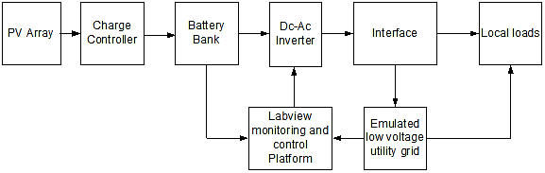
Block Diagram of Test Bed
Aims:
Study and analysis of microgrid systems and identification of requirements for power transfer and power quality.
Development of a laboratory scale microgrid structure to incorporate a photovoltaic system interfaced with the low-voltage ac grid, and locally connected electrical loads.
Develop control algorithms to enable power transfer from the renewable energy source to the ac grid, taking into account power quality requirements of the grid.

Slide 4
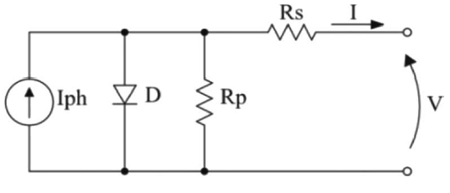

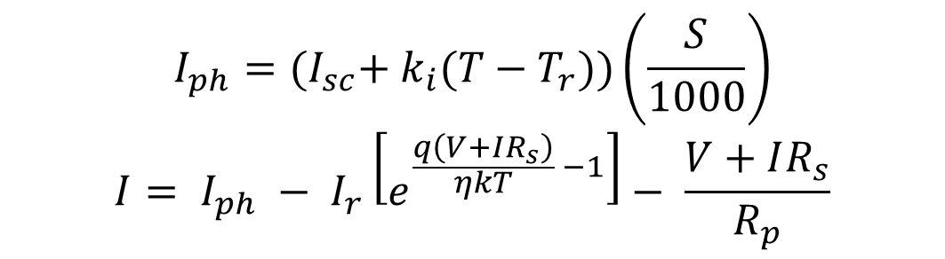
Equivalent circuit model of a PV panel
$$I_{ph}={(I}_{sc}+ k_{i}(T−T_{r}))\left(\frac{S}{1000}\right)$$
$$I= I_{ph} − I_{r}\left[e^{\frac{q\left(V+IR_{s}\right)}{ηkT} −1}\right]− \frac{V+IR_{s}}{R_{p}}$$

Slide 5
PV Current vs Voltage Characteristics

Slide 6
PV power characteristic for different irradiation levels

Slide 7
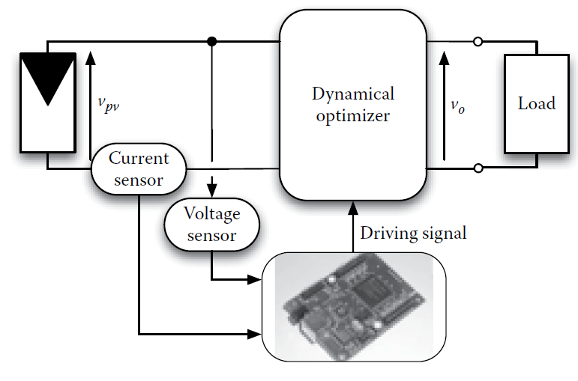

MPPT implementation
$$R_{in}\left(d\right)= \frac{R_{Load}}{{M(d)}^{2}}; V_{pv}\left(d\right)= \frac{V_{o}}{M(d)}$$

Slide 8
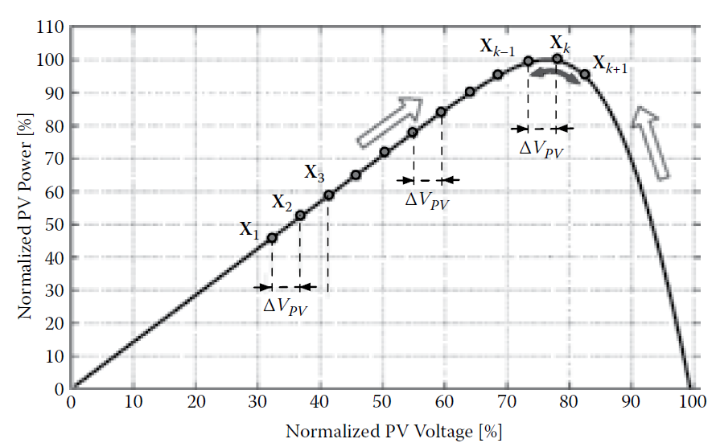
Movement of operating point using Perturb & Observe Algorithm

Slide 9
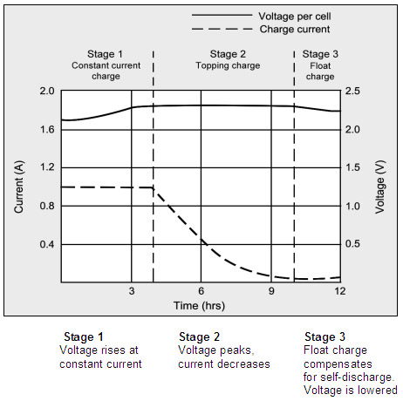
Typical battery charging profile

Slide 10
Experimentally obtained charging profile

Slide 11
Power flow control
Power transfer from dc to ac side
Operation at leading/ lagging power factors
Requirement for low current THD
Real time monitoring of current and voltage

Slide 12
Block diagram of power flow control

Slide 13
Expected output current

Slide 14
Implementation

Slide 15
Simulation and experimental tests
Line voltage and injected current
Current THD
Tracking of power command
Tracking of phase angle command

Slide 16
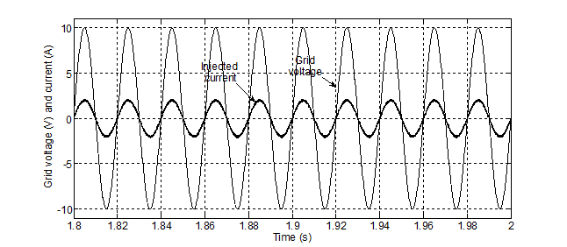
Operation at unity p.f
Simulation
Experimental

Slide 17
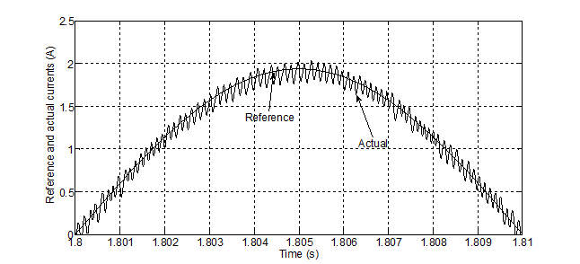
Current tracking

Slide 18
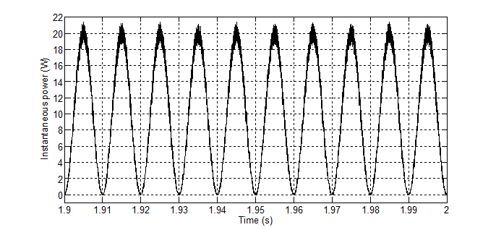
Instantaneous power
Simulation
Experimental

Slide 19
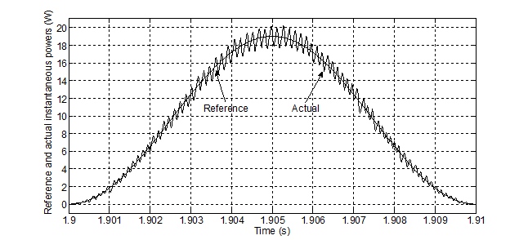
Power tracking

Slide 20
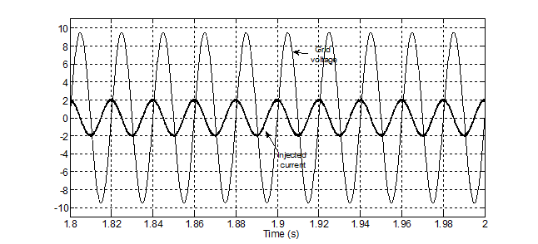
Operation with purely reactive power
Simulation
Experimental

Slide 21
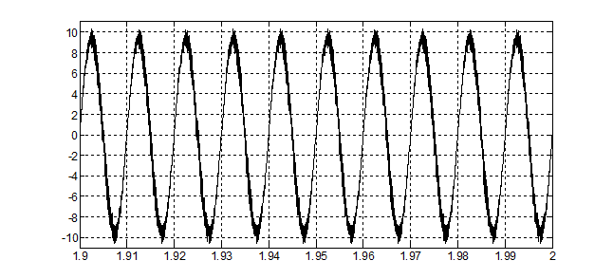
Instantaneous power response
Simulation
Experimental

Slide 22
Conclusion and Further Work
We have experimentally demonstrated how power transfer between dc grid sides can be achieved at adjustable power factor
Further works:
Improve on the battery charging profile using a custom-made solar charger which we can manipulate using different MPPT techniques.
Improve on the current waveform by using a proportional resonant controller.
Integrate a wind turbine in the system

Slide 23
Questions?

